Slide 1



IOT-Based Road Safety System
B-TECH, EEE
Batch 2026
Student details:
Supervisors:
Supervisor : Dr. Veerabhadra
Co-supervisor: Mr. Raunak Das
25ETEE003007-B.V.Pragya
25ETEE003011-C.P.Srivarshini
25ETEE003013-Chethana.M
25ETEE003017-Jananya A.G
25ETEE003019-Kavya.G
‹#›

Slide 2
Outline
Introduction
Title and Aim
Objectives
Block Diagram
Code
Diagrams and Images
Working Video
Conclusion
References
‹#›
‹2›

Slide 3
Introduction
An automated streetlight system built using IoT technology that controls street lighting intelligently based on real-time environmental conditions.
The system detects ambient light levels and human/vehicle motion to automatically turn ON/OFF and adjust brightness.
Equipped with a GSM module and buzzer to send instant SMS alerts to authorities when in danger enhancing public safety and enabling remote monitoring.
Features a manual override button for emergency , making the system both fully automated and human-controllable.
‹3›

Slide 4
Title and Aim
Title : IOT-BASED ROAD SAFETY SYSTEM
Aim : To develop a smart street light system using Arduino and sensors to improve safety, visibility, and energy efficiency
‹4›

Slide 5
Objectives of the project
To conduct literature review on enhancing road safety system and identification of research gap.
To significantly reduce power consumption by automating the switching and dimming of lights based on ambient light levels (LDR).
To provide brighter illumination when vehicles or pedestrians are detected and ensure streets are not entirely dark, reducing accident rates and improving security.
To incorporate manual emergency switches (SOS) on poles that notify authorities, enhancing women's safety and speeding up emergency response times.
To reduce electricity consumption by controlling street lights intelligently based on environmental conditions or movement detection.
5

Slide 6
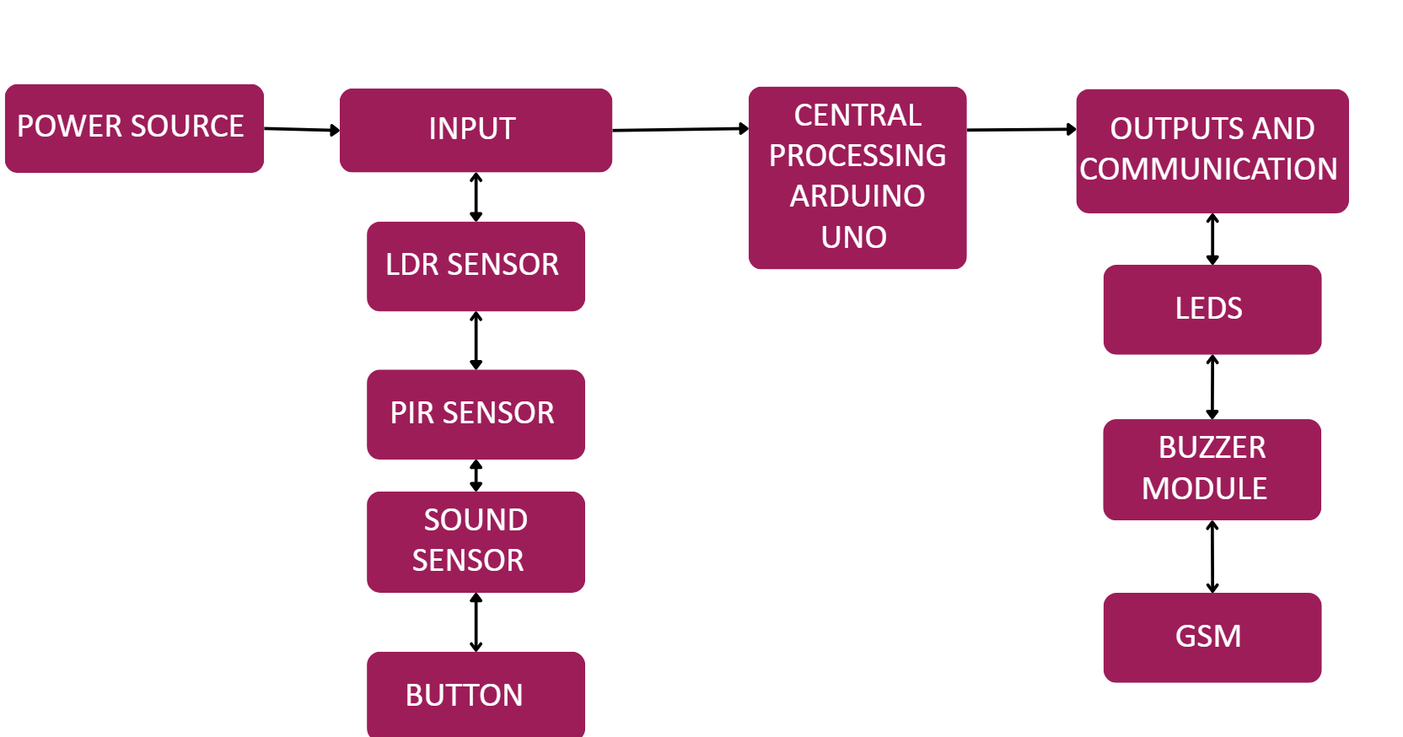
Block Diagram
‹#›
‹6›

Slide 7
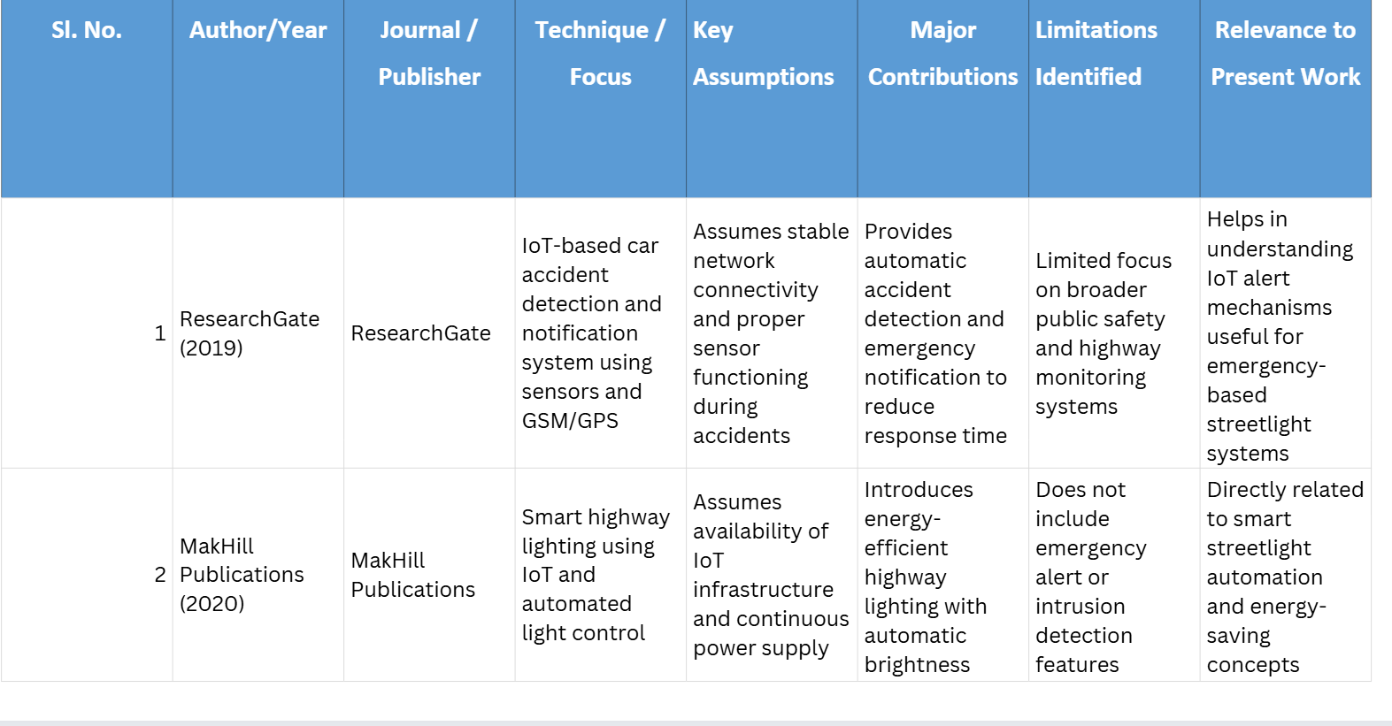
Literature Survey
‹7›

Slide 8
Literature Survey
Sl. No. | Author(s) & Year | Journal / Publisher | Technique / Focus | Key Assumptions | Major Contributions | Limitations Identified | Relevance to Present Work
3 | Semantic Scholar (2021) | Semantic Scholar | IoT applications for road and human safety | Assumes sensors can accurately monitor road conditions and human presence | Highlights integration of IoT devices for accident prevention and public safety | Generalized approach with limited implementation details | Supports the safety-oriented objective of the present project
4 | Prime Scholars (2023) | Prime Scholars | GPS and GSM-based accident detection and alert system | Assumes accurate GPS tracking and GSM communication in all locations | Improves emergency response through real-time accident alerts | Dependent on network availability and may fail in remote areas | Useful for implementing emergency notification features in the project
‹8›

Slide 9
Literature Survey
Sl. No. | Author(s) & Year | Journal / Publisher | Technique / Focus | Key Assumptions | Major Contributions | Limitations Identified | Relevance to Present Work
5. | arXiv (2024) | arXiv | Multi-sensor intrusion detection system using IoT sensors | Assumes sensors can reliably detect suspicious movement or intrusion | Enhances security through multi-sensor monitoring and detection | Complex sensor integration may increase system cost and maintenance | Relevant for integrating PIR and safety monitoring features in smart streetlight systems
‹9›

Slide 10
Components Required
Arduino Uno R3
Pir sensor
Ldr sensor
GSM sim 900a
Sound sensor
220 ohm resistor
Yellow led
Jumper wires
Breadboard
Push button
Active Buzzer
‹#›
‹10›

Slide 11
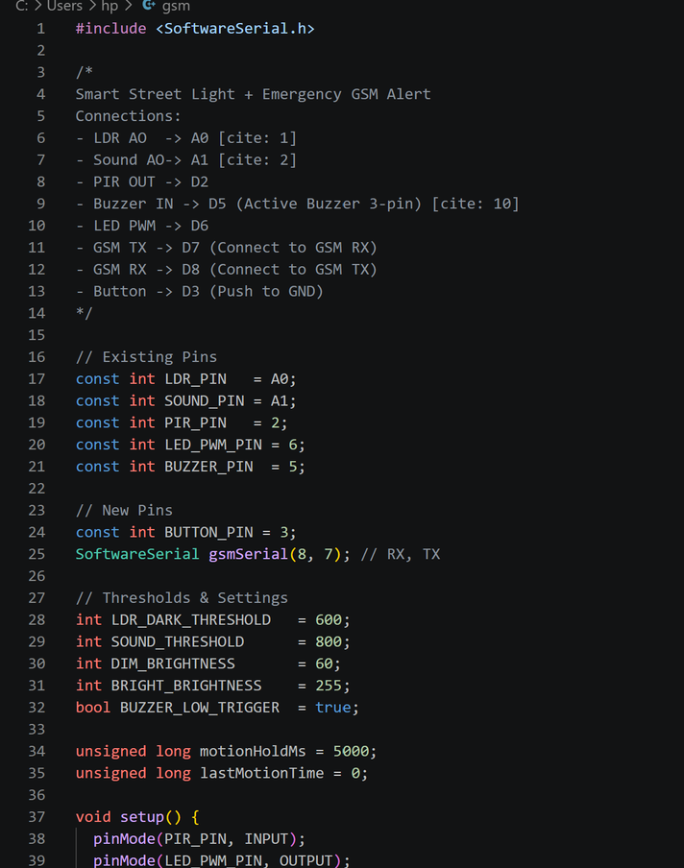

Code
‹11›

Slide 12
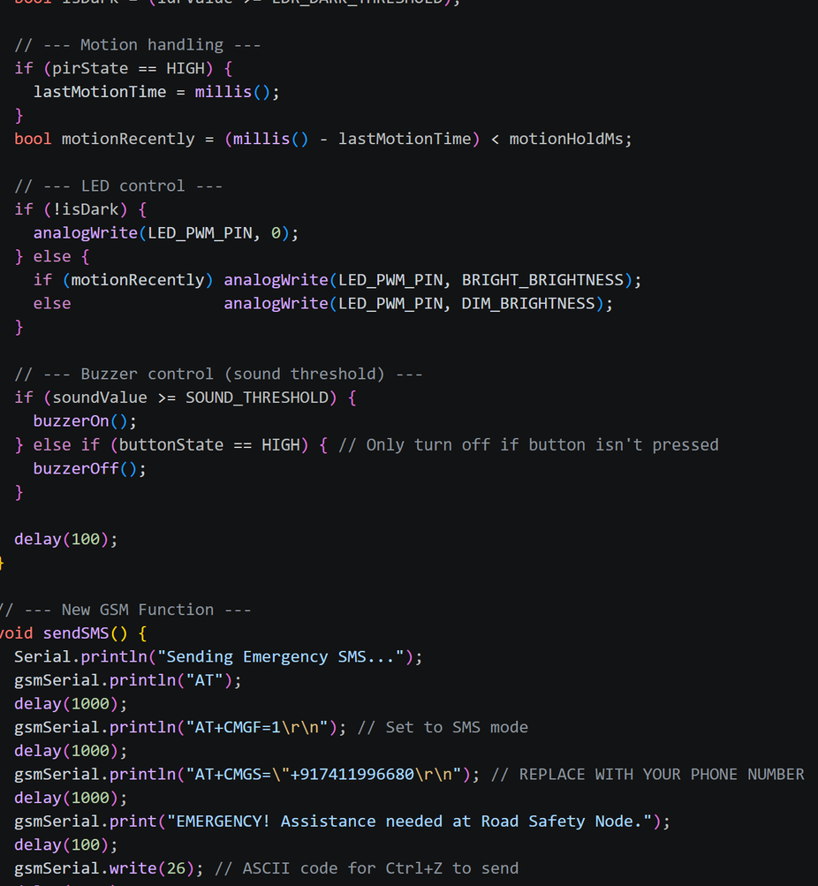
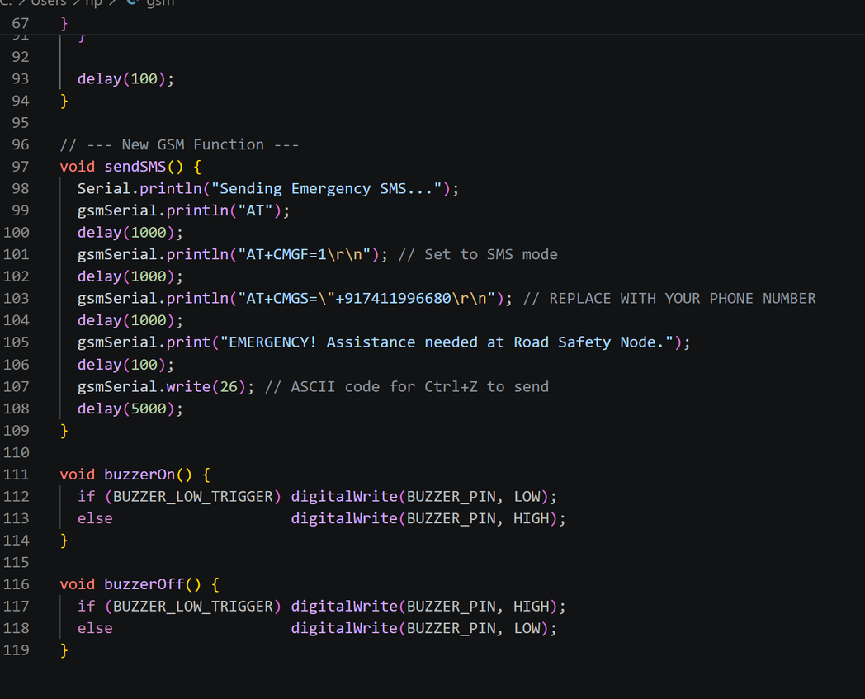
Code
‹12›

Slide 13
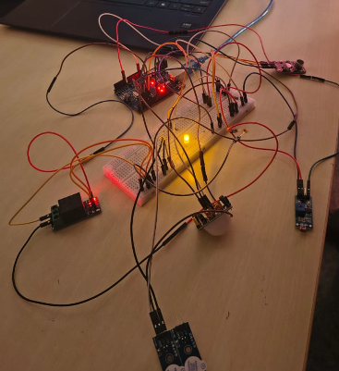
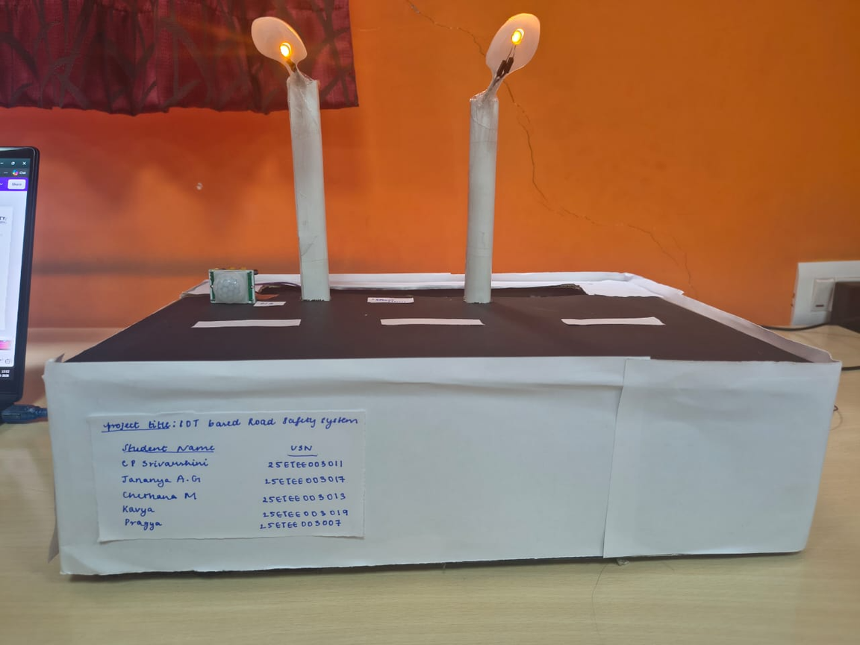
Photos of the prototype model
Fig1.Initial Connections
Fig2.Model of our project
‹#›
‹13›

Slide 14
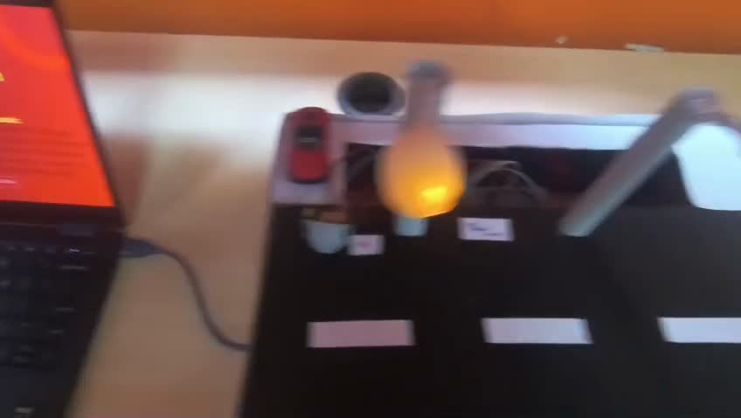
Video
‹14›

Slide 15
Conclusion
Developed an IoT-based smart streetlight and road safety system to improve public safety and energy efficiency during nighttime.
Implemented automatic light control using LDR and PIR sensors along with GSM-based emergency alert features.
The system provides a cost-effective, automated, and reliable solution for smarter and safer public spaces.
‹15›

Slide 16
References
1.ResearchGate (2019) IoT based car accident detection and notification algorithm for general road accidents
2. MakHill Publications (2020) Smart highway lighting solution based on IoT.
3. Semantic Scholar (2021) Application of IoT for human safety on road.
4. Prime Scholars (2023) Accident detection and alert system GPS and GSM on IoT based.
5. arXiv (2024) Multi-sensor intrusion detection system.
‹16›

Slide 17

‹17›

